Slide 1
Discrete event simulation and queueing systems

Slide 2
Two-workstation assembly line
Alice & Bob manufacture cardboard boxes on a 2-workstation assembly line. Alice pre-assemblies them and Bob glues a pre-assembled box.
There is no storage area between workstations. Once a box is preassembled by Alice she needs to wait to be pickup by Bob for gluing. When there is no pre-assembled box, Bob needs to wait for Alice.
Workstation 1
Workstation 2
Final products
A
B
Alice
Bob
Source: Chase, Aquilano: Production and Operations Management, IRWIN, 1995, 7th edition., str. 676

Slide 3
Historical performance of the assembly line
Workstation 1
Workstation 2
Final products
A
B
Alice
Bob
Service time | Occurencies
Seconds | Alice | Bob
5-14,99 | 4 | 4
15-24,99 | 6 | 5
25-34,99 | 10 | 6
35-44,99 | 20 | 7
45-54,99 | 40 | 10
55-64,99 | 11 | 8
65-74,99 | 5 | 6
75-84,99 | 4 | 4

Slide 4
Historical performance of the assembly line
Workstation 1
Storage
Workstation 2
Final products
A
S
B
Alice
(queue)
Bob
Service time | Occurencies
Seconds | Alice | Bob
5-14,99 | 4 | 4
15-24,99 | 6 | 5
25-34,99 | 10 | 6
35-44,99 | 20 | 7
45-54,99 | 40 | 10
55-64,99 | 11 | 8
65-74,99 | 5 | 6
75-84,99 | 4 | 4

Slide 5
Managerial questions
What is the performance of each workstation?
What is the total performance of the assembly line?
How much time Alice is spending waiting for Bob and how long Bob is waiting for Alice
What happens when a storage for pre-assembled products is placed between Bob and Alice?
What is the percentage of time that each workstation is busy?

Slide 6
Queuing system simulation
Applications: shops, banks, call-center, computing jobs at a Hadoop server, hospital
If a workstation is busy the new customer takes place in a queue
WORKSTATION (SERVER)
ARRIVING CUSTOMERS
RANDOMIZED ARRIVAL TIME
QUEUE (FIFO)
COMPLETED ITEMS
?
7
6
5
4
RANDOMIZED
SERVICE TIMES

Slide 7
QUEUING SYSTEMS
Typical data being collected
Item (object, agent)
Total time spent in the system
Total waiting times
Queue
Average, mean, std dev. of queue length
Average, mean, std dev. of queue wait times
Workstation (server, resource)
load (% time)
Number of workstation use
System throughput

Slide 8
Queuing simulation
Item (entity, agent)
Have properties (fields that change when an item travels through the system)
Can have many types and priorities
Workstation (server, resource)
Limited capacity (usually 1)
Can represent machines, people, space
Queue
can have limited capacity
Priority: FIFO, LIFO, CLV, shortest distance

Slide 9
Simulation clock
Initial value: 0
Updating
Event scheduling for discrete-event simulations. Analyze only points of time when a change of system state is observed. The model clock will advance to those discrete points of time.
The clock can be managed by a schedule object

Slide 10
Event scheduling
Event occurs at the end of any action in the system
Any new action can only start at a time of an event
Unconditional events
a new item/agent arrives
Server completes processing an item
Conditional events – starting processing an item
In the schedule only unconditional events are stored
Conditional events are processed while processing the unconditional ones

Slide 11
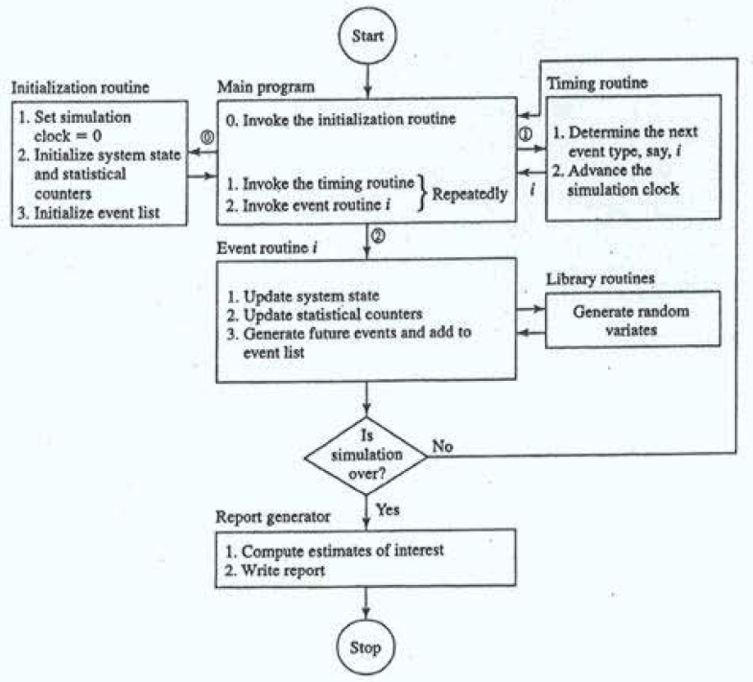
Source: Law (2007)

Slide 12
Historical performance of the assembly line
Workstation 1
Workstation 2
Final products
A
B
Alice
Bob
Service time | Occurencies
Seconds | Alice | Bob
5-14,99 | 4 | 4
15-24,99 | 6 | 5
25-34,99 | 10 | 6
35-44,99 | 20 | 7
45-54,99 | 40 | 10
55-64,99 | 11 | 8
65-74,99 | 5 | 6
75-84,99 | 4 | 4

Slide 13
Historical performance of the assembly line
Workstation 1
Storage
Workstation 2
Final products
A
S
B
Alice
Bob
Service time | Occurencies
Seconds | Alice | Bob
5-14,99 | 4 | 4
15-24,99 | 6 | 5
25-34,99 | 10 | 6
35-44,99 | 20 | 7
45-54,99 | 40 | 10
55-64,99 | 11 | 8
65-74,99 | 5 | 6
75-84,99 | 4 | 4

